Slide 1
Introduction to AI + ML

Slide 2
Outline
Introduction to Artificial Intelligence
Introduction to Machine Learning
ML Learning Types
Introduction to Deep Learning
Introduction to Generative AI
Content Generation

Slide 3

Introduction to Artificial Intelligence

Slide 4
Intro to AI
Artificial Intelligence (AI) is a broad field of computer science focused on building systems that can perform tasks normally requiring human intelligence
Tasks: Reasoning, learning, perception, decision making
AI is not one technology – it is an umbrella term covering many different techniques and approaches
AI research and development began in the 1950s
Three Common “levels” of AI:
Artificial Narrow Intelligence (Narrow AI)
Artificial General Intelligence (General AI)
Artificial Superintelligence (Super intelligent AI)

Slide 5
Three Common “Levels” of AI
Narrow AI: Systems built for one specific task.
General AI: A hypothetical system with human-level reasoning across any task.
Super intelligent AI: A hypothetical AI surpassing human intelligence broadly.
Level | Status Today | Examples
Narrow AI (ANI) | Exists – Widely used | Spam filters, voice assistants, Recommendation engines, LLMs
General AI (AGI) | Hypothetical | N/a – research goals
Superintelligence (ASI) | Theoretical | N/a – speculative

Slide 6
AI Intro (cont)
Narrow AI is used broadly today.
Everyday examples of Narrow AI:
Recommendation engines (Netflix, Spotify, YouTube)
Navigation Apps predicting traffic
Spam detection
Chatbots
Image recognition in phone cameras
Machine Learning: subset of AI in which systems learn patterns from data.
Deep Learning: subset of machine learning which adds layered neural networks
Generative AI: A subset of deep learning focused on creating new content (text, images, audio, code), rather than classifying or predicting from existing data.
Examples: Claude, ChatGPT, Midjourney, GitHub Copilot
As a developer, it is important to understand where a project’s ‘AI’ claim sits.
Rule-based system? Predictive ML model? Generative model?
This shapes what you can realistically build, test and debug

Slide 7
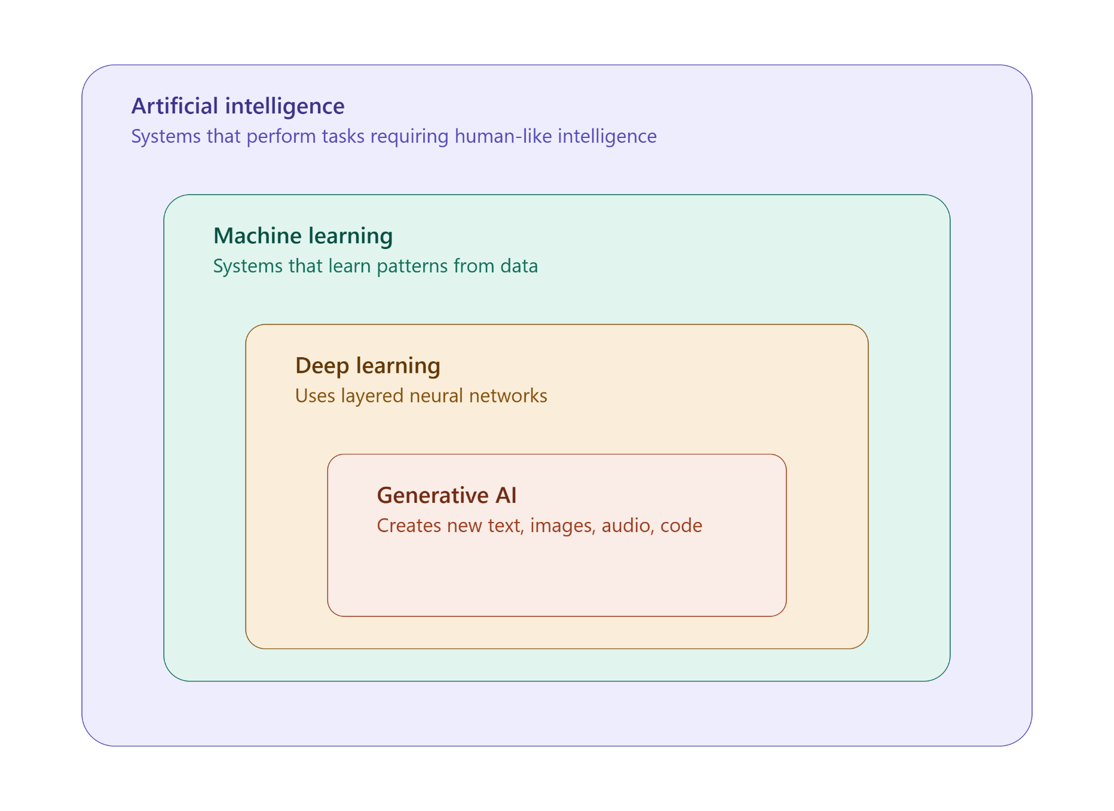
AI Subsets

Slide 8
Introduction to Machine Learning

Slide 9
Machine Learning
Machine Learning (ML) is a subset of AI in which systems learn patterns from data, rather than being explicitly programmed with fixed rules for every scenario.
Traditional programming vs ML Programming:
Traditional Programming:
Developer writes explicit rules
Program applies rules to data
Program produces output
Machine Learning Programming:
Developer provides data and desired outcomes
The algorithm learns the rules (a “model” is formed)
The model applies those learned rules to new data
Common real-world ML applications:
Email spam filters, product recommendations, credit scoring, predictive text

Slide 10
Machine Learning | Key Terms
Model: The trained system that makes predictions or decisions
Training Data: The historical data used to teach the model
Training: The process of the algorithm learning patterns from data
Features: The individual measurable inputs the model uses (e.g. square footage, number of bedrooms)
Prediction / Inference: The model’s output when given new, unseen data.

Slide 11
Machine Learning | Why?
Why does ML exist?
Some problems are too complex, nuanced, or data-drive to hand-code effective rules for
Fraud detection, recommending products, recognizing handwriting
Machine Learning is not “magic” – it uses a combination of statistics and pattern recognition to define outputs
Machine learning is only as good as the data it is trained on

Slide 12
ML Learning Types

Slide 13
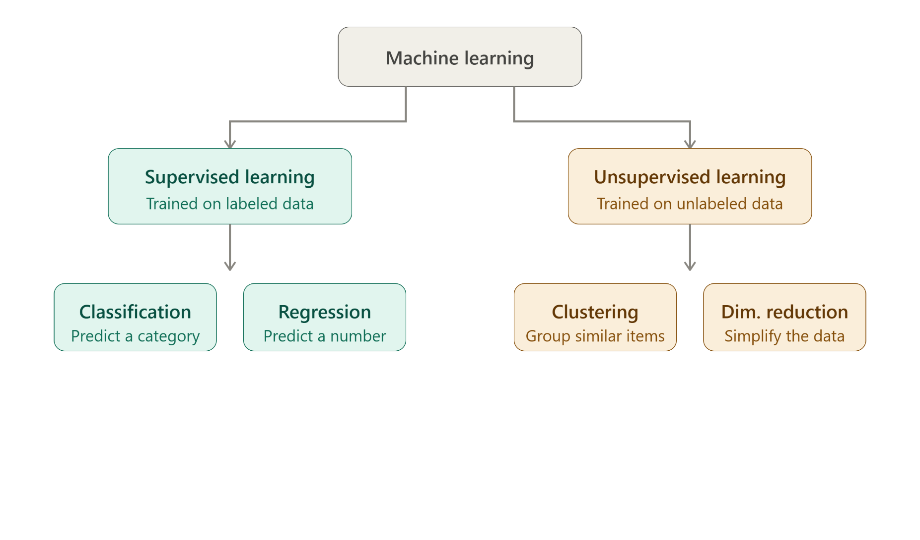
Machine Learning Types

Slide 14
Supervised Learning
Supervised learning is a type of machine learning where the model is trained on labeled data
Labeled data: Data that already includes the “correct answer” for each example
The model learns to map inputs to known outputs, then applies that mapping to new, unseen data
Two main task types:
Classification: predicting a category (e.g. “Spam”, “not Spam”
Regression: predicting a numeric value (e.g. a home’s sale price)

Slide 15
Unsupervised Learning
Unsupervised Learning is a type of machine learning where the model is trained on unlabeled data
Unlabeled Data: data with no predefined “correct answer”
The model’s job is to find hidden structure, patterns, or groupings in the data on it’s own
Two main tasks:
Clustering: grouping similar data points (e.g. Fraud detection, or customer segmentation)
Dimensionality reduction: simplifying data while preserving important structure (e.g. recommendation systems, or image compression)

Slide 16
Supervised vs Unsupervised Learning
Supervised Learning learns “from an answer key”; unsupervised learning “looks for structure/patterns without one”
Supervised Learning Examples:
Spam Detection, Credit Scoring, medical diagnosis prediction, price forecasting
Unsupervised Learning Examples:
Customer segmentation, anomaly/fraud detection, recommendation grouping, organizing large document sets
Neither approach is “better”, the right choices depends on whether labeled data is available and what question you are trying to answer
[bonus] Semi-supervised learning: A Machine Learning type which uses a small amount of labeled data alongside a larger amount of unlabeled data.

Slide 17
Introduction to Deep Learning

Slide 18
Deep Learning
Deep Learning is a subset of machine learning in which layered neural networks are used to learn patterns from data
Inspired loosely by the structure of the human brain
Core building block: Nodes
The artificial Neural network, composed of layers of interconnected “neurons” (nodes):
Input layer: receives the raw data (e.g. pixel values of an image)
Hidden Layer(s): intermediate layers that progressively transform and combine the data to detect patterns
“Deep” learning refers to having many of these layers
Output Layer: produces the final prediction

Slide 19
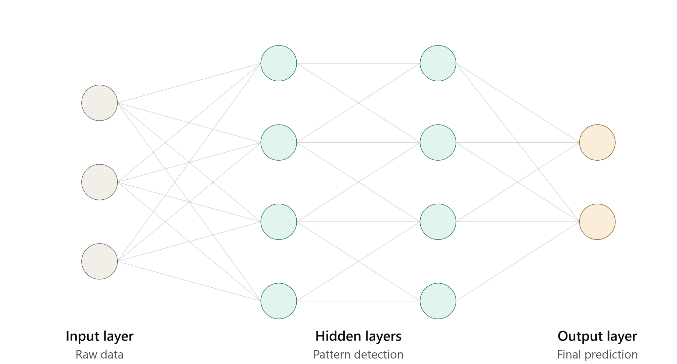
Deep Learning | Layers

Slide 20
Deep Learning
Training a neural network involves adjusting internal values called weights so the network’s predictions get closer to the correct answer over time
The adjustment of weights is done in a process called backpropagation.
Backpropagation: network compares its prediction to the correct answer, calculates how wrong it was, and works backward through the layers, adjusting weights to reduce that error.
Why does deep learning matter?
It can automatically detect complex, layered patterns in raw unstructured data (images, audio, text), that would be difficult to hand-engineer features for using traditional ML
Deep learning generally requires significantly more data and computing power than traditional ML techniques
Common real-world applications: image recognition, speech-to-text, self-driving car perception systems, generative ai.

Slide 21
Introduction to Generative AI

Slide 22
Intro to Generative AI
Generative AI (Gen AI) is a subset of deep learning focused on creating new content (text, images, audio, code), rather than classifying or predicting from existing data.
Contrast this with ML/DL, which are both typically used to classify, predict or detect
Most modern generative ai is powered by a deep learning architecture called the transformer, which is good at understanding relationships between elements in a sequence (words in a sentence, patches in an image, tokens in code)
GenAI utilizes deep learning, neural networks, and machine learning techniques to enable computers to produce content that closely resembles human-created output autonomously.
These algorithms learn from patterns, trends and relationships within the training data to generate coherent and meaningful content.
The models can generate new text, images, or other forms of media by predicting and filling in missing or next possible pieces of information.

Slide 23
How does GenAI work?
Generative AI utilizes advanced algorithms, typically, to generate new content based on given training data.
The process involves several key steps: Data Collection, Training, Latent Space Representation, Generation, Iterative Refinement.
It’s important to note that the training process and specific algorithms used can vary depending on the generative AI model employed.
Data Collection: A large dataset contains examples of the type of content the generative AI model will generate.
Training: The generative AI model is training on the collected dataset, typically involving deep learning techniques. During training, the model analyzes the patterns, structures, and features of the dataset to learn and understand the underlying characteristics.

Slide 24
How does GenAI work?
Latent Space Representation: The trained generative AI model creates a latent space representation (LSR), which is a mathematical representation of the patterns and features it has learned from the training data. This latent space acts as a compressed, abstract representation of the dataset.
Generation: Using the learned LSR, the Gen AI model can generate new content by sampling points in the latent space and decoding them back into the original content format.
Iterative Refinement: Generative AI models are often trained through an iterative process:
Training
Evaluate the generated output
Adjust the model’s parameters to improve the quality and realism of the generated content.

Slide 25
Intro to Generative AI
Large Language Models (LLMs) are a type of generative AI trained on massive amounts of text, allowing them to generate human-like text, answer questions, summarize content and write code.
Generative AI input is known as a prompt.
Prompts can include text, images or other instructions given to a generative AI model to produce an output.

Slide 26
Intro to Generative AI
GenAI spans multiple content type, each with its own specialized model types:
Text Generation: LLMs like Claude, ChatGPT
Image Generation: Diffusion models like Midjourney, DALL-E
Code Generation: GitHub Copilot, Claude Code
Audio/Speech Generation: voice cloning and music generation tools
Important Note: Generative AI models can produce confident-sounding but incorrect output, often called hallucinations.
Output should always be scrutinized and reviewed, especially in professional or production contexts
Generative AI tools are increasingly part of the day-to-day developer workflow. Understanding how they work, and their limitations is crucial for your job.

Slide 27
Content Generation

Slide 28
Gen AI in Text Generation
Generative AI can generate coherent and contextually relevant text by learning patterns and structures from a large corpus of text data.
Models, such as recurrent Neural Networks (RNNs), Transformers, or Language Models are training on textual data to understand the relationships between words and the context in which they are used.
By leveraging this learned knowledge, generative AI models can generate new text that follows grammatical rules, maintains coherence, and aligns with the given context or topic.
These models capture the statistical patterns of language and use them to generate text that is contextually relevant and appears as if it could have been written by a human

Slide 29
Examples of Text Generation Applications
Chatbots and Virtual Assistants
Content Generation
Language Translation
Text Summarization
Personalized Recommendations and Ads
Text-to-Speech Synthesis

Slide 30
Generative AI in Image Generation
Generative AI is used to generate realistic images by training models on large datasets of real images.
These models, such as Generative Adversarial Networks (GANs) or Variational Autoencoders (VAEs), learn the patterns and structures present in the training data.
They then utilize this learned knowledge to generate new images that resemble the original dataset
GANs consist of a generator that produces synthetic (generated) images and a discriminator that distinguishes between real and generated images.
Through an adversarial training process, the generator improves its ability to create realistic images that fool the discriminator
VAEs learn a compressed representation of the images called the latent space and generate new images by sampling points in this space and decoding them.
These generative AI techniques have revolutionized image synthesis, enabling applications in computer graphics, art, design, and beyond.

Slide 31
Examples of Image Generation Applications
Image-to-Image Translation
Face Generation and Editing
Photo Realism and Art Generation
Style Transfer and Fusion

Slide 32
Pros of Generative AI
Creativity and Novelty: GenAI enables the creation of new and unique content, whether it’s images, music or text. It can generate innovative and original outputs that may not have been created otherwise.
Automation and Efficiency: Generative AI automates the process of content creation, saving time and resources. It can generate large volumes of content quickly and efficiently, assisting in tasks like data augmentation, content generation, and design exploration.
Personalization and Customization: Generative models can be trained on specific data or preferences, allowing for personalized recommendations, tailored content, and customized user experiences
Exploration and Inspiration: GenAI can provide inspiration to artists, designers, and writers by generating diverse variations, exploring creative possibilities, and serving as a starting point for further creative exploration.

Slide 33
Cons of Generative AI
Ethical concerns: GenAI raises ethical concerns, particularly regarding the misuse of synthetic media, deepfakes, and potential infringement of intellectual property rights. It requires careful consideration and responsible usage to avoid malicious or deceptive applications.
Lack of control: Generative models can produce outputs that are difficult to control or fine-tune to specific requirements. The generated content may not always meet the desired expectations or adhere to specific guidelines.
Dataset Bias and Generalization: Generative models heavily rely on the training data they are exposed to. If the training data is biased or limited, the generated outputs may inherit those biases or struggle with generalizing to unseen scenarios.
Computational Resources and Complexity: Training and deploying generative models can be computationally intensive and require significant resources, including high-performance hardware and substantial training times. Implementing and maintaining these models can be complex and resource demanding
Quality and Coherence: While generative models have made significant progress, they may still struggle wit producing outputs that consistently exhibit high quality, coherence, and contextual relevance. Fine-tuning and careful model selection may be necessary to achieve desired results.

